Slide 1
Statistics for the Skeptical
Making Better Decisions
˜
Tim Hargreaves
Notes:
Two objectives:
Why be skeptical? Scenarios that seem clear but are actually more subtle. Costs of getting things wrong
What to do? Real-world examples, bit of stats, change perspective

Slide 2
Introduction
˜
Why be skeptical?
Notes:
Start with introduction
Who am I and why this talk matters

Slide 3

Hello, I’m Tim
˜
Data Scientist @ AstraZeneca
UG Mathematics and Statistics
www.ttested.com
Notes:
First data scientist
Seen a lot of bad statistics with real world costs
Particularly interesting in statistical models that are transparent and interpretable
Blog about all things data related: ethics, AI, algorithms, telling a story
If I had to sum up in one word it’s difficult…

Slide 4
What Do I Do?
˜
Analytics?
Business Insight?
Manage
Uncertainty
Information Science?
Statistics?
Computational Chemistry?
Data Science?
Maths?
Computer Science?
Notes:
Not really sure what I do
Mixture of many disciplines
Underlying thread: uncertainty

Slide 5
Three Key Ideas About Uncertainty
˜
Most issues in the world are not black and white
Data rarely implies a single conclusion
Statistical analysis never gives rise to certainty
Silberzahn, R. et al. (2018) ‘Many Analysts, One Data Set: Making Transparent How Variations in Analytic Choices Affect Results’, Advances in Methods and Practices in Psychological Science, 1(3), pp. 337–356. doi: 10.1177/2515245917747646.
Notes:
First point should not be controversial
At least we can rely on data; crunch the numbers and see what they say…
Well no. One dataset on racial bias in football, 61 analysts in 29 teams. 50/50 split on responses
69% found evidence, 31% did not
29 different analyses, 21 unique combinations of covariates
Prior belief had no impact, neither did peer ratings
But when we do agree then we can be sure
Well, no. Statistics can never give an answer
Just how likely something is to have occurred
Biased coin example – ask audience

Slide 6

Plan B: Reddit & Co
˜
Notes:
Compare to odds of sharing a Birthday
Physics experiments use 5-sigma. 1 in 30-million. Still could happen with enough experiments
Existential crisis that every statistician goes through
How does this link to statistics. Statistics is the language of uncertainty. Gives statistics a lot of power…

Slide 7
“
There are three kinds of lies: lies, damned lies, and statistics.
—Author disputed (popularised by Mark Twain)
Notes:
Benjamin Disraeli – PM 1870s
If you don’t know how to handle uncertainty then someone who does will take advantage of that

Slide 8
Consequences of Uncertainty
˜
87%
3 in 5
$3tn
˜
˜
of scientists in chemistry have experienced failure to reproduce results
Americans don’t have trust in mass media to report news fully, accurately, and fairly
The estimated annual cost of poor data quality to the US economy
Monya Baker (2016) ‘1500 scientists lift the lid on reproducibility’, Nature, 25 May. Available at: https://www.nature.com/news/1-500-scientists-lift-the-lid-on-reproducibility-1.19970 (Accessed: 18 Jan 2020)
Megan Brenan (2019), ‘American’s Trust in Mass Media Edges Down to 41%’, Gallup, 26 Sept. Available at: https://news.gallup.com/poll/267047/americans-trust-mass-media-edges-down.aspx (Accessed: 18 Jan 2020)
Thomas C. Redman (2016) ‘Bad Data Costs the U.S. $3 Trillion Per Year’, Harvard Business Review, 22 Sept. Available at: https://hbr.org/2016/09/bad-data-costs-the-u-s-3-trillion-per-year (Accessed: 18 Jan 2020)
Notes:
Bad research practice + hype + bias
Online media is driven towards sensationalism and bad statistics is a tool for this
Tangible quantity

Slide 9
“
International development is the intersectional study of policies and projects used to develop the environment, societies, and governments around the globe. This includes areas such as food and water security, human rights and refugee crises, healthcare and education, economics, business and innovation, technology and engineering, as well as law and politics.
—WIDS SU Information Page
International development is the intersectional study of policies and projects used to develop the environment, societies, and governments around the globe. This includes areas such as food and water security, human rights and refugee crises, healthcare and education, economics, business and innovation, technology and engineering, as well as law and politics.
—WIDS SU Information Page
International development is the intersectional study of policies and projects used to develop the environment, societies, and governments around the globe. This includes areas such as food and water security, human rights and refugee crises, healthcare and education, economics, business and innovation, technology and engineering, as well as law and politics.
—WIDS SU Information Page
Notes:
Uncertainty through the lens of WIDS
What is WIDS
Glad to know I won’t use all of these but a select few

Slide 10
Introduction
˜
Why be skeptical?

Slide 11
Law (well, Crime)
˜
Cherry-picking data points
Notes:
Breaking my own rules already

Slide 12
“
The annual ONS violent crime report shows that deaths from knife crime are at a four-year high
—Radio 4 News (paraphrased from memory)
Other (citable) examples:
5-year high: Thomas Mackintosh, Steve Swann (2019) ‘Domestic violence killings reach five-year high’, BBC News, 13 Sept. Available at: https://www.bbc.co.uk/news/uk-49459674 (Accessed: 16 Jan 2020)
9-year high: Alan Travis (2018), ‘One in five women have been sexually assaulted, analysis finds’, The Guardian, 8 Feb. Available at: https://www.theguardian.com/uk-news/2018/feb/08/sexual-assault-women-crime-survey-england-wales-ons-police-figures (Accessed: 16 Jan 2020)
8-year high: Richard Ford, Greg Hurst (2019) ‘Knife crime rises to 8-year high’, The Times, 18 Oct. Available at: https://www.theguardian.com/uk-news/2018/feb/08/sexual-assault-women-crime-survey-england-wales-ons-police-figures (Accessed: 16 Jan 2020)
Notes:
Inspiration for the talk
Thoughts? In line with what you would expect? Cause for concern?
Take issue with ‘4-year high’
Other examples that can be found
Asked many people about this and they offer justifications or mention how sad it is
As a statistician, I read this differently

Slide 13
“
Breaking: man flips coin twice, both outcomes are heads. Police force begin enquiry
—A headline from a parallel universe
Notes:
May not seem the same
If we remove and bias and expectation they are identical
Crime rate is made up of two things. Base rate + natural variation
Example: Blinking per minute has constant rate but each interval will have a different amount due to noise
Why? Suppose crime rate was constant with random variation

Slide 14
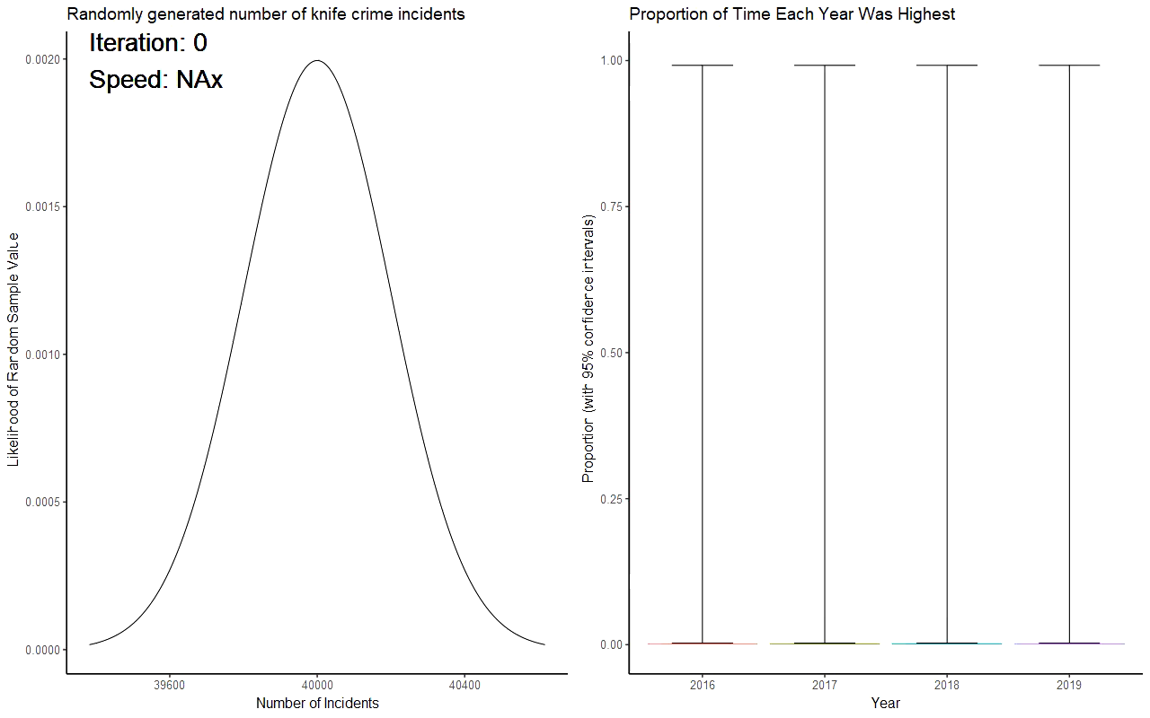

Slide 15
“
Latest: coin flip turns up tails. The people demand an explanation
—A headline from a parallel universe (on a slow news day)

Slide 16
Null Hypothesis
˜
The belief that there is no significant difference between groups of interest, any observed difference being due to random chance
Lexico. Available at: https://www.lexico.com/definition/null_hypothesis (Accessed: 18 Jan 2020)

Slide 17
“
AI algorithm predicts whether an unborn child will develop ADHD with a 92% accuracy
—Journal of Computational Biology
Thoughts?
Danielson, ML, et al. (2016) ‘Prevalence of Parent-Reported ADHD Diagnosis and Associated Treatment Among U.S. Children and Adolescents’. Journal of Clinical Child & Adolescent Psychology, Volume 47, 2018 - Issue 2

Slide 18
A ‘Null’ Model
˜
Will a child develop ADHD? |  | Prediction |  | Total
 |  | No | Yes
Actual | No | 92% | 0% | 92%
 | Yes | 8% | 0% | 8%
Total |  | 100% | 0% | 100%
92%
0%

Slide 19
The Cost of Forgetting The Null Hypothesis
˜
£8,000
Money spent by AZ on a single statistical model that was proven to perform worse than random chance

Slide 20
Law (well, Crime)
˜
Cherry-picking data points

Slide 21
Economics
˜
Asking the tough questions

Slide 22
Two Questions
˜
Did you have a valid ticket the last time you caught a train?
Why should I believe you?
Pauline Tuffour (2017) ‘FOI request for ticket evasion statistics’, TFL, 29 March. Available at: https://tfl.gov.uk/corporate/transparency/freedom-of-information/foi-request-detail?referenceId=FOI-2430-1617 (Accessed: 18 Jan 2020)

Slide 23
“
Have you ever witnessed an act of sexual violence and either didn’t intervene or report it?
— Keele University Sexual Violence Survey (Dr Kelly Prince)

Slide 24
Hawthorne Effect
˜
The inclination of people who are the subjects of an experimental study to change or improve […] their behaviour simply because it is being evaluated or studied
Will Kenton (2019) ‘Hawthorne Effect’, Investopedia, 24 Nov. Available at: https://www.investopedia.com/terms/h/hawthorne-effect.asp (Accessed: 16 Jan 2020)

Slide 25
An (Overly Simple) Strategy
˜
Flip a coin out of the sight of the interviewer
H
T
Give the ‘bad’ answer
Give the ‘true’ answer
Finally: Transform the data to ignore the added noise
Josh Joy, Mario Gerla (2017) ‘Differential Privacy By Sampling’, arXiv:1708.01884 [cs.CR]

Slide 26
Differential Privacy
˜
A system for collecting data by describing the patterns of groups while withholding information about individuals
In simple terms: Plausible deniability
Cynthia Dwork et al. (2006) ‘Calibrating Noise to Sensitivity in Private Data Analysis’, Journal of Privacy and Confidentiality, 7 (3), 17-51. DOI:10.29012/jpc.v7i3.405

Slide 27
A Spectrum of Privacy
˜
More privacy (+honesty)
More statistical power
Alvim, M.S., Andrés, M.E., Chatzikokolakis, K., Degano, P. and Palamidessi, C., 2011, September. Differential privacy: on the trade-off between utility and information leakage. In International Workshop on Formal Aspects in Security and Trust (pp. 39-54). Springer, Berlin, Heidelberg.

Slide 28
Economics
˜
Asking the tough questions

Slide 29
Healthcare
˜
A recipe for fear

Slide 30
“
Did you hear that XYZ has been linked to increased risk of cancer?
—A familiar 21st century conversation point

Slide 31
“
Did you hear that drinking Twinning’s Turkish Apple Tea has been linked to winning games of snakes and ladders?
—An exaggerated counterpoint
Notes:
200 participants
100 games
50 with/without tea

Slide 32
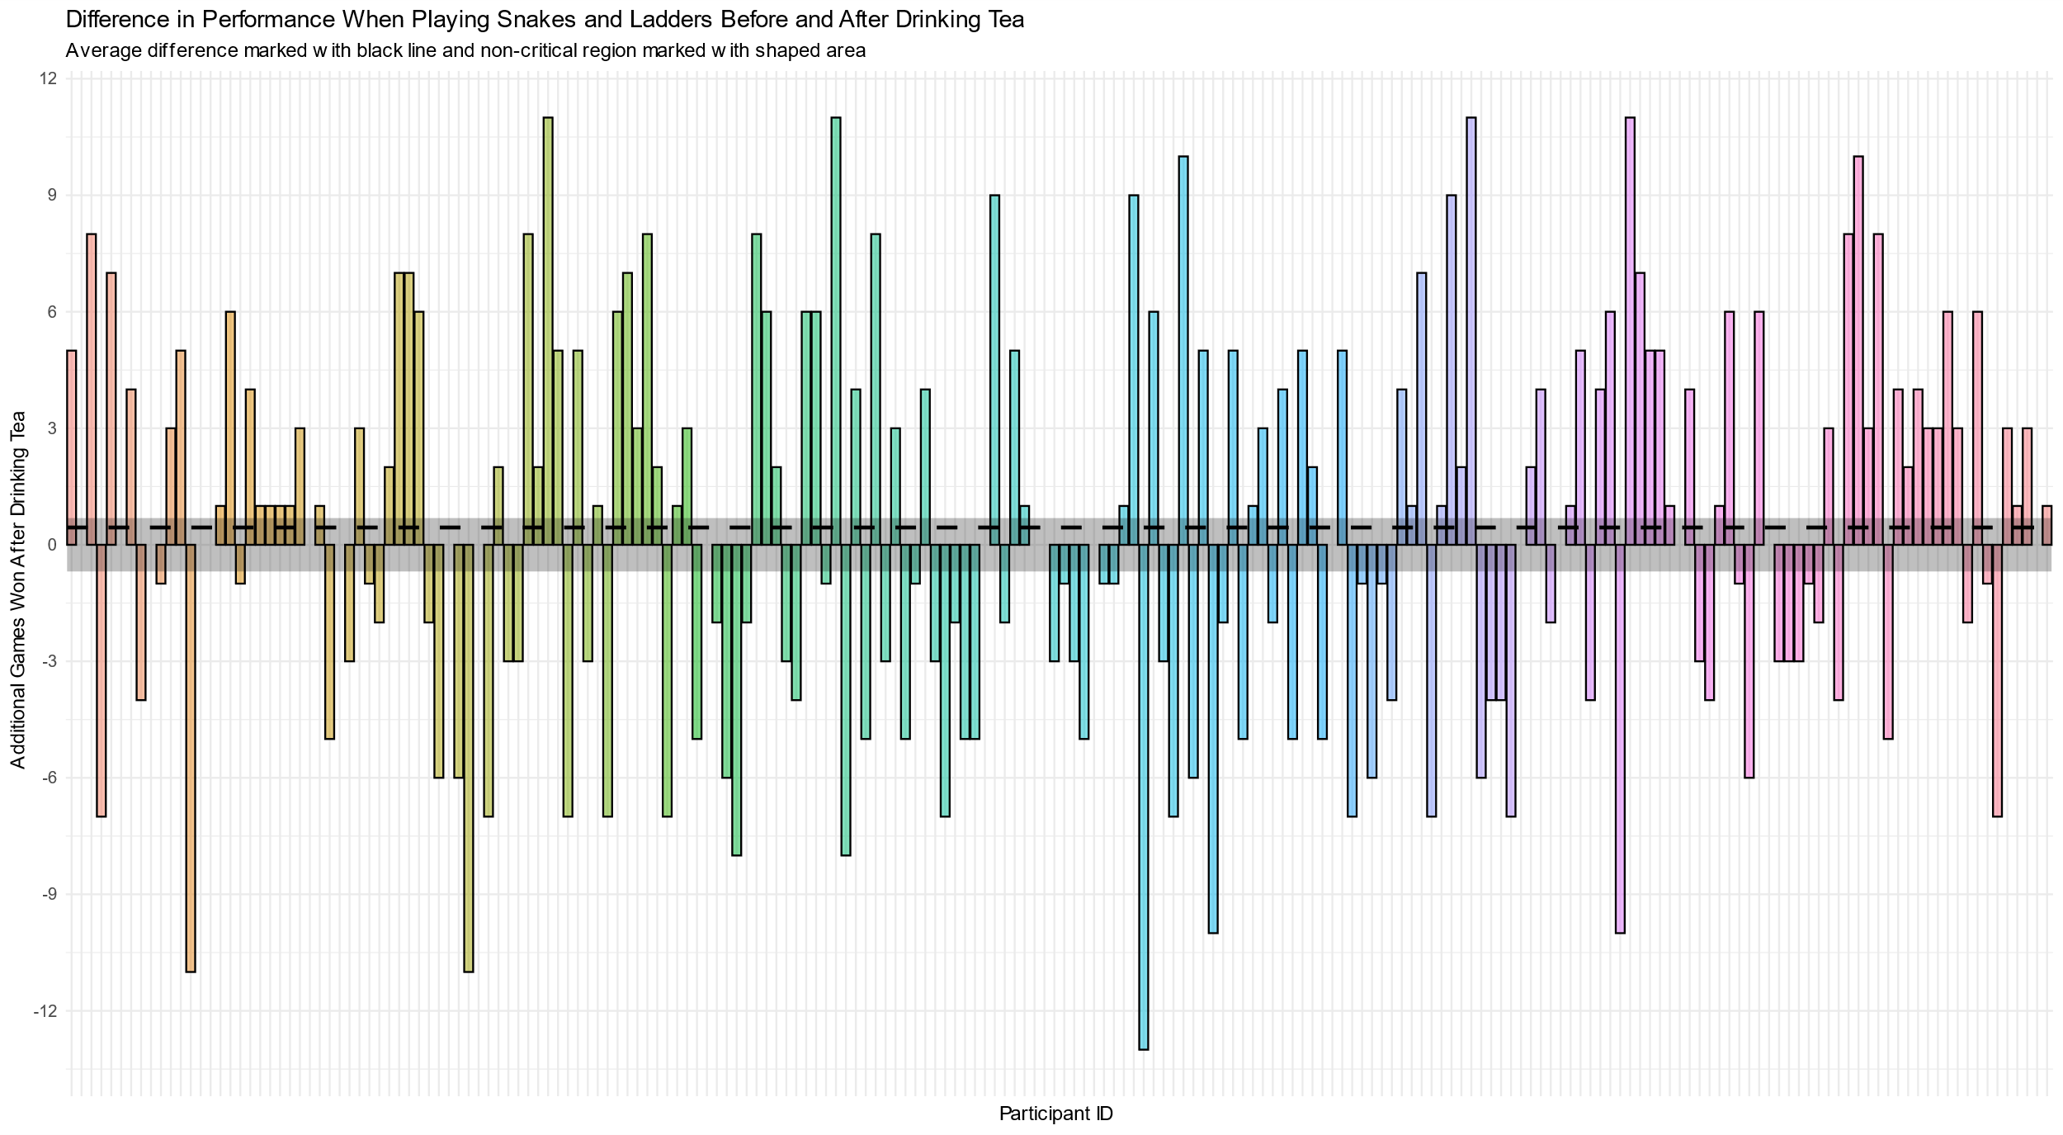
Notes:
5%
20 blends

Slide 33
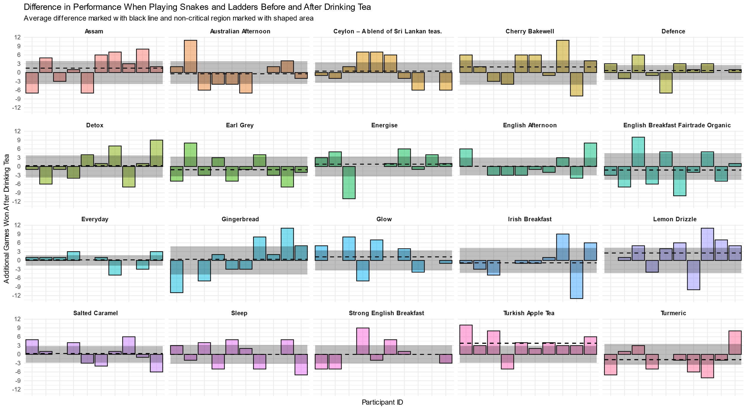
Notes:
64% chance of one being significant
100 tests -> 99.5%

Slide 34
Data Dredging
˜
The misuse of repeated data analysis to find patterns in data that can be presented as statistically significant despite being due to random noise
In simple terms: Data before hypothesis
Davey Smith, G., Ebrahim, S. (2002). ‘Data dredging, bias, or confounding’. BMJ. 325 (7378): 1437–1438. doi:10.1136/bmj.325.7378.1437

Slide 35
“
SVR_poly2 was the only member of the [18] models to accurately predict the most selective test reactions
—Science (Journal)
Zahrt, A.F., Henle, J.J., Rose, B.T., Wang, Y., Darrow, W.T. and Denmark, S.E., 2019. Prediction of higher-selectivity catalysts by computer-driven workflow and machine learning. Science, 363(6424), p.eaau5631.

Slide 36
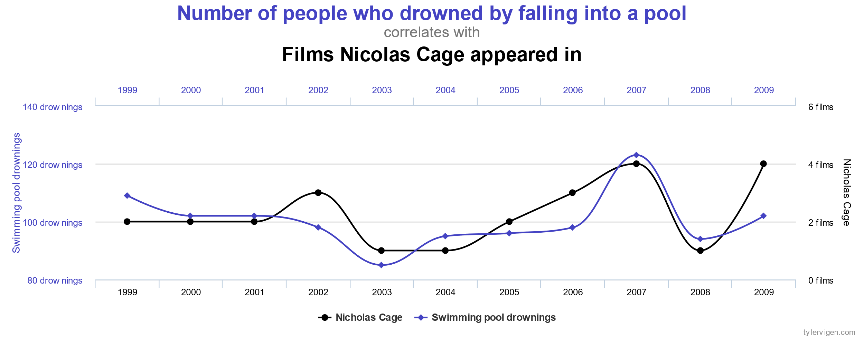
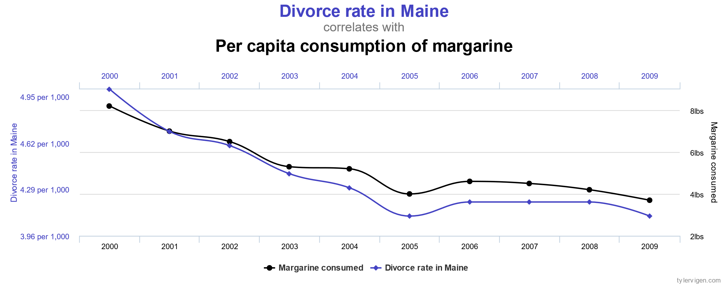
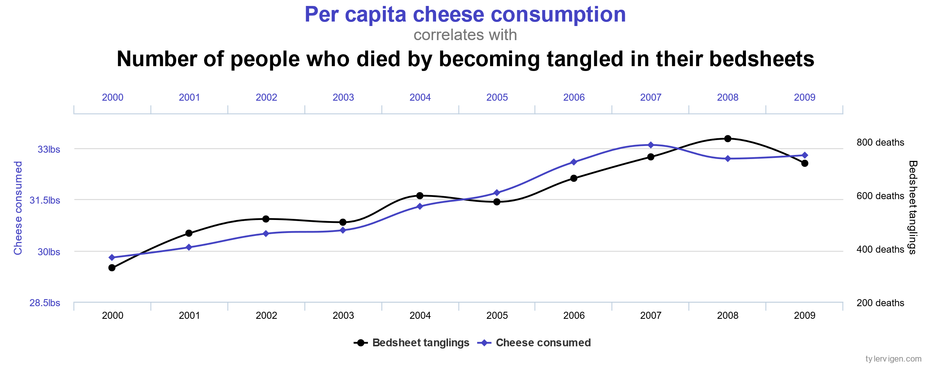
Spurious Correlations
˜
Spurious Correlations. Available at: https://www.tylervigen.com/spurious-correlations (Accessed on 18 Jan 2020)

Slide 37
Healthcare
˜
A recipe for fear

Slide 38
Food and Water Security
˜
True change or statistical noise

Slide 39
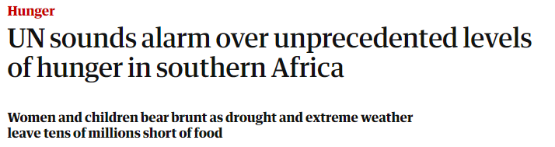
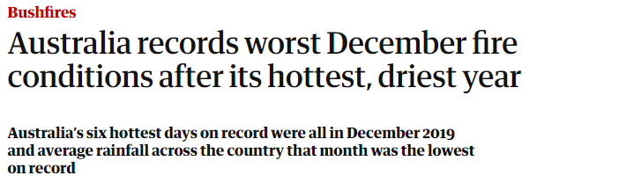
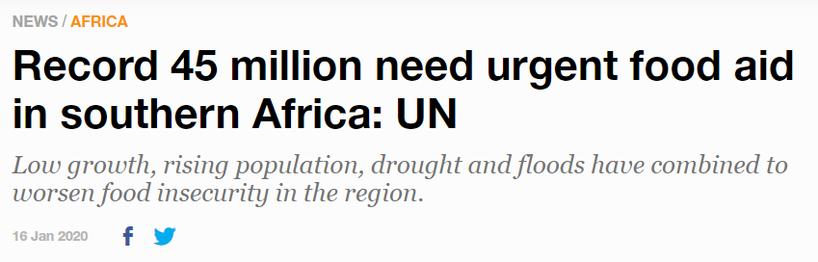
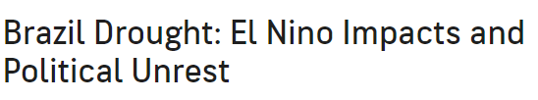
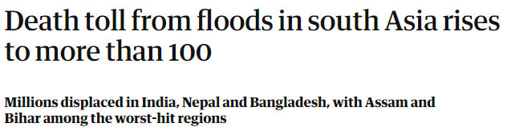
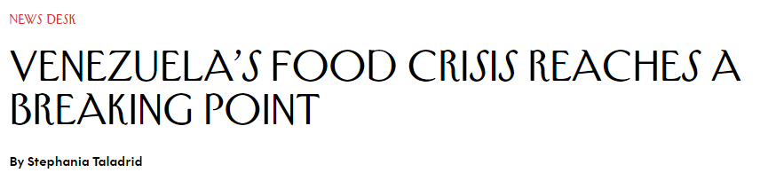
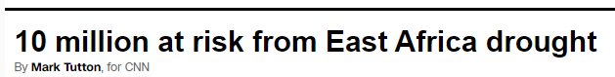
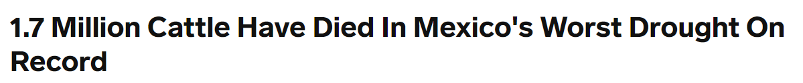
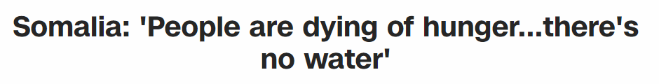
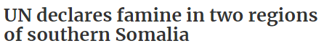
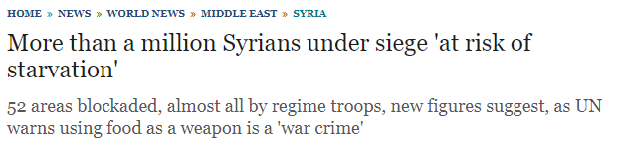
The Challenge of Keeping Track
˜

Slide 40
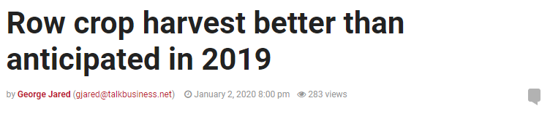
Worse: How Can We Tell If We’re Making a Difference
˜
Simple: just look for an improvement.
Right?

Slide 41
Regression to the Mean
˜
The phenomenon that occurs when a random variable is extreme on its first measurement but closer to the mean (i.e. average) on its second measurement
In simple terms: Two extreme values are unlikely
Everitt, B.S. (2002) The Cambridge Dictionary of Statistics, CUP. ISBN 0-521-81099-X

Slide 42
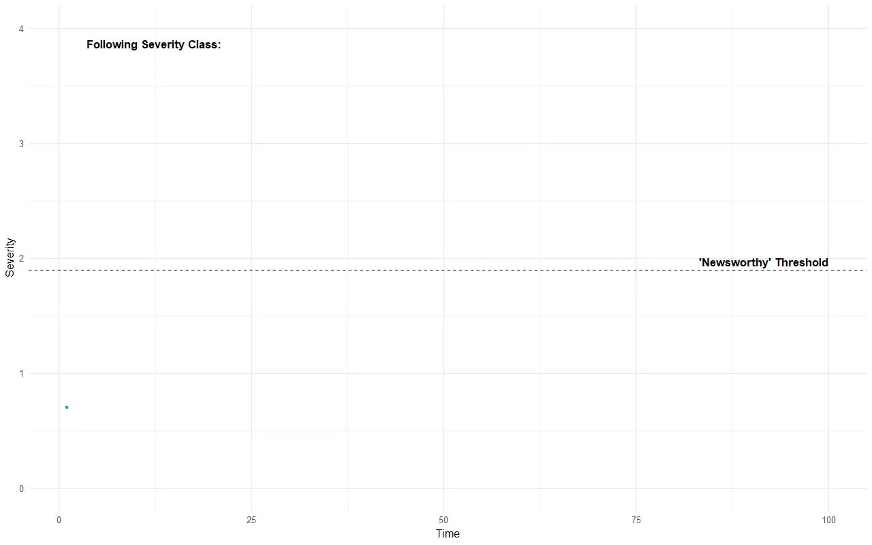

Slide 43
Food and Water Security
˜
True change or statistical noise

Slide 44
Education
˜
Seeing patterns that aren’t there

Slide 45
UC Berkeley Admission Figures (1973)
˜
 | Men |  | Women
 | Applicants | Admitted | Applicants | Admitted
Total | 8442 | 44% | 4321 | 35%
Is this cause for worry?
David Freedman, Robert Pisani, and Roger Purves (2007), Statistics (4th edition), W. W. Norton. ISBN 0-393-92972-8

Slide 46
Breakdown for the Three Largest Departments
˜
 | Men |  | Women
Department | Applicants | Admitted | Applicants | Admitted
A | 823 | 62% | 108 | 82%
B | 560 | 63% | 25 | 68%
C | 325 | 37% | 593 | 34%
David Freedman, Robert Pisani, and Roger Purves (2007), Statistics (4th edition), W. W. Norton. ISBN 0-393-92972-8

Slide 47
“
Let us identify those of the 85 [departments] with bias [towards men] sufficiently large. […] There prove to be four such departments. Looking further, we find six departments biased in the opposite direction. […] There is even a suggestion of a surplus of woman.
P.J. Bickel, E.A. Hammel and J.W. O'Connell (1975). "Sex Bias in Graduate Admissions: Data From Berkeley" (PDF). Science. 187 (4175): 398–404. doi:10.1126/science.187.4175.398

Slide 48
Simpson’s Paradox
˜
An effect in which groups of data show one particular trend, but this trend is reversed when the groups are combined together
This occurs when underlying causal groups are not properly taken into account
Simpson's Paradox. Brilliant.org. Retrieved 21:25, January 18, 2020, from https://brilliant.org/wiki/simpsons-paradox/
Judea Pearl. Causality: Models, Reasoning, and Inference, Cambridge University Press (2000, 2nd edition 2009). ISBN 0-521-77362-8

Slide 49
The Underlying Causal Relation?
˜
Women tended to apply to smaller, competitive departments (e.g. English)
Men tended to apply to larger, less competitive departments (e.g. engineering, chemistry)
P.J. Bickel, E.A. Hammel and J.W. O'Connell (1975). "Sex Bias in Graduate Admissions: Data From Berkeley" (PDF). Science. 187 (4175): 398–404. doi:10.1126/science.187.4175.398

Slide 50
“
An increase in body weight correlates with a higher top running speed
—A simpler, fictional example

Slide 51
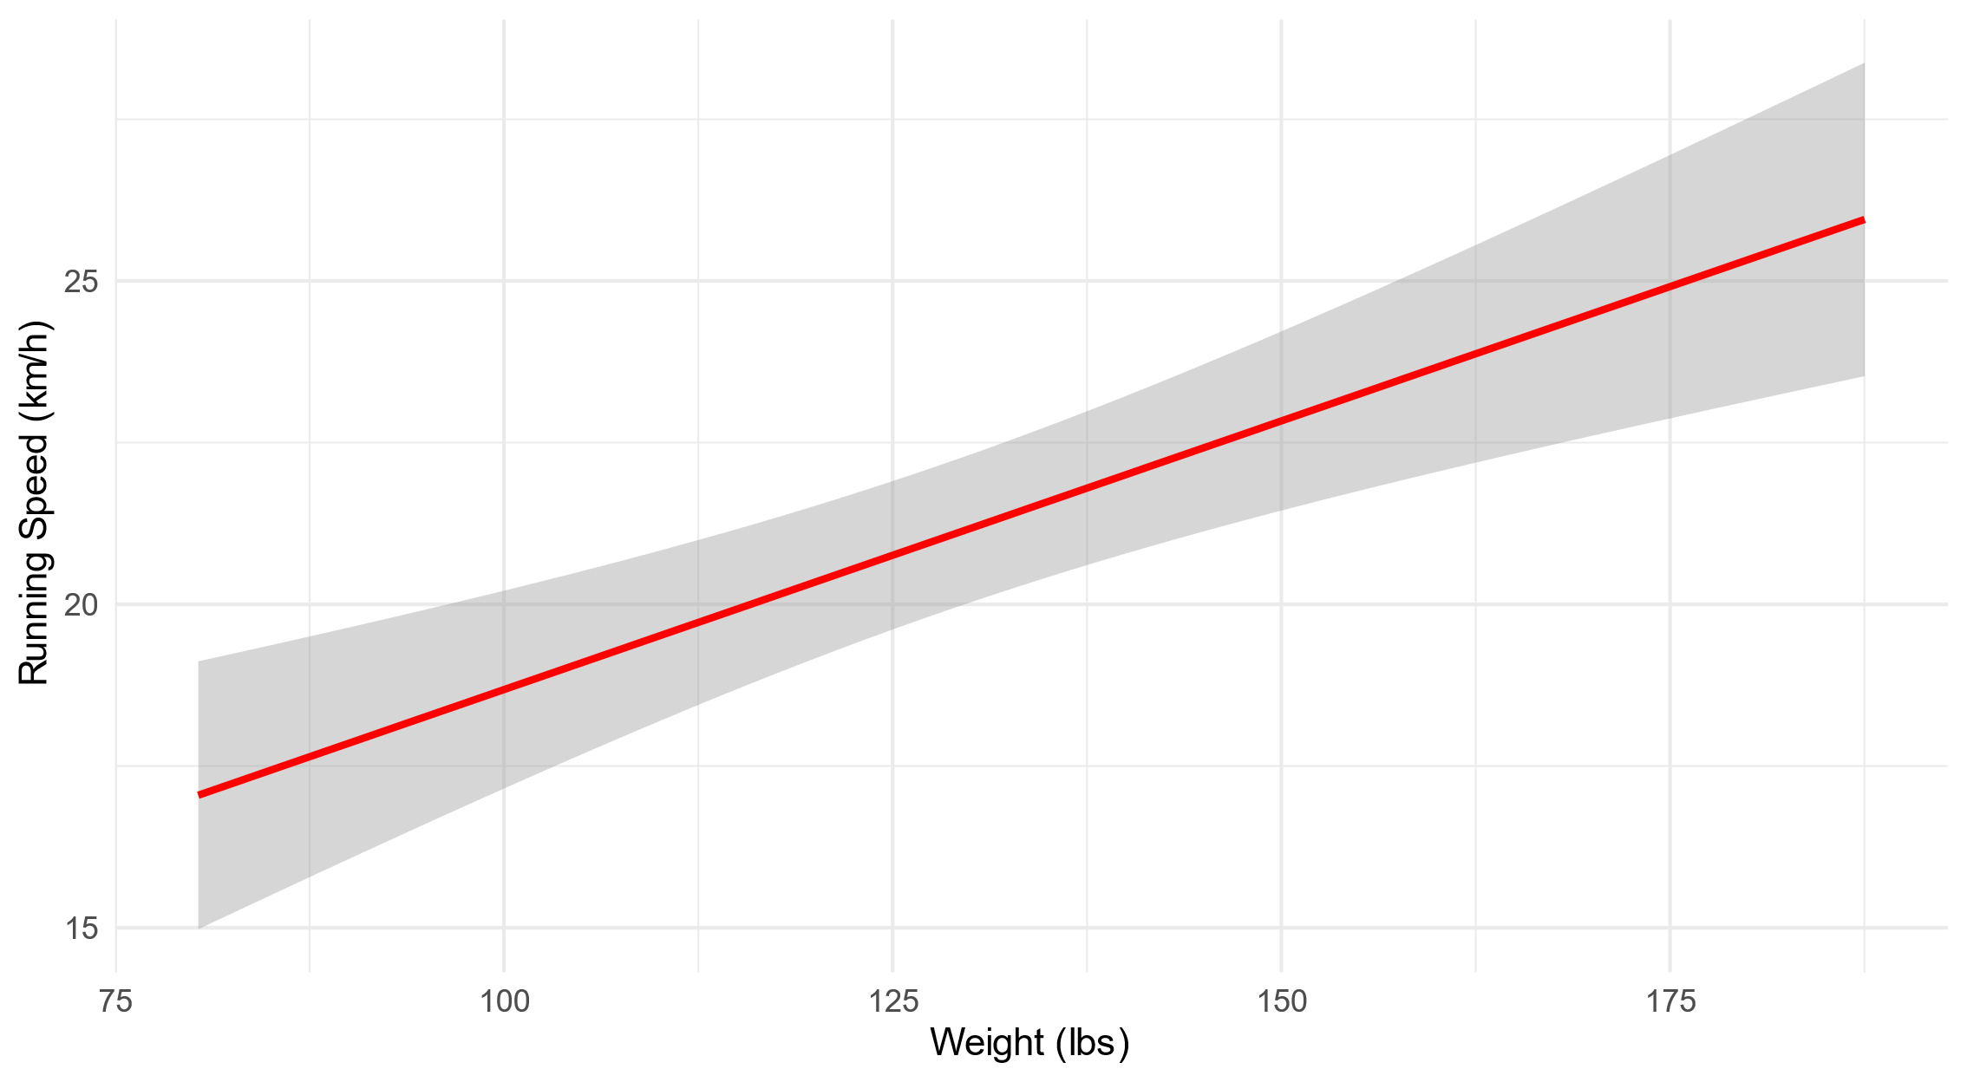
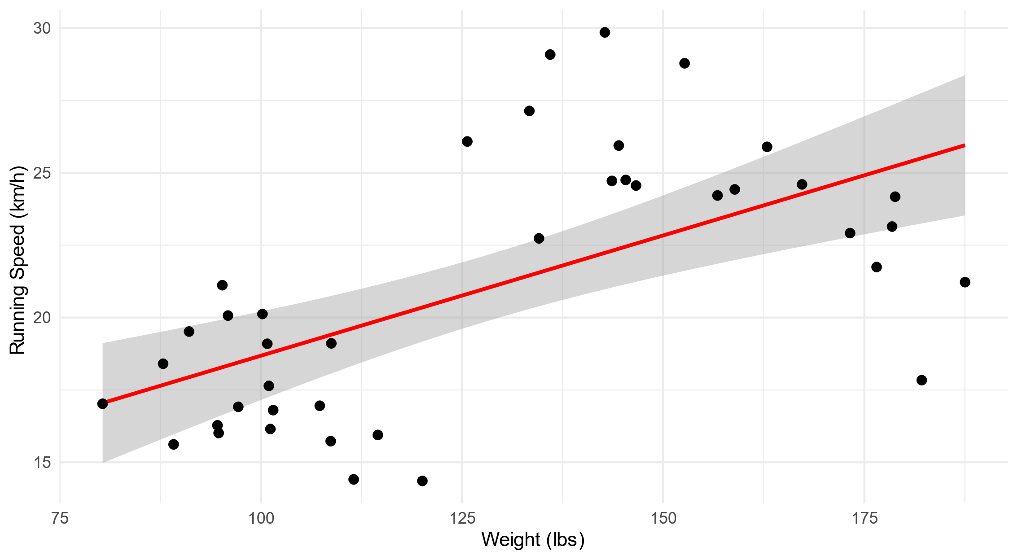
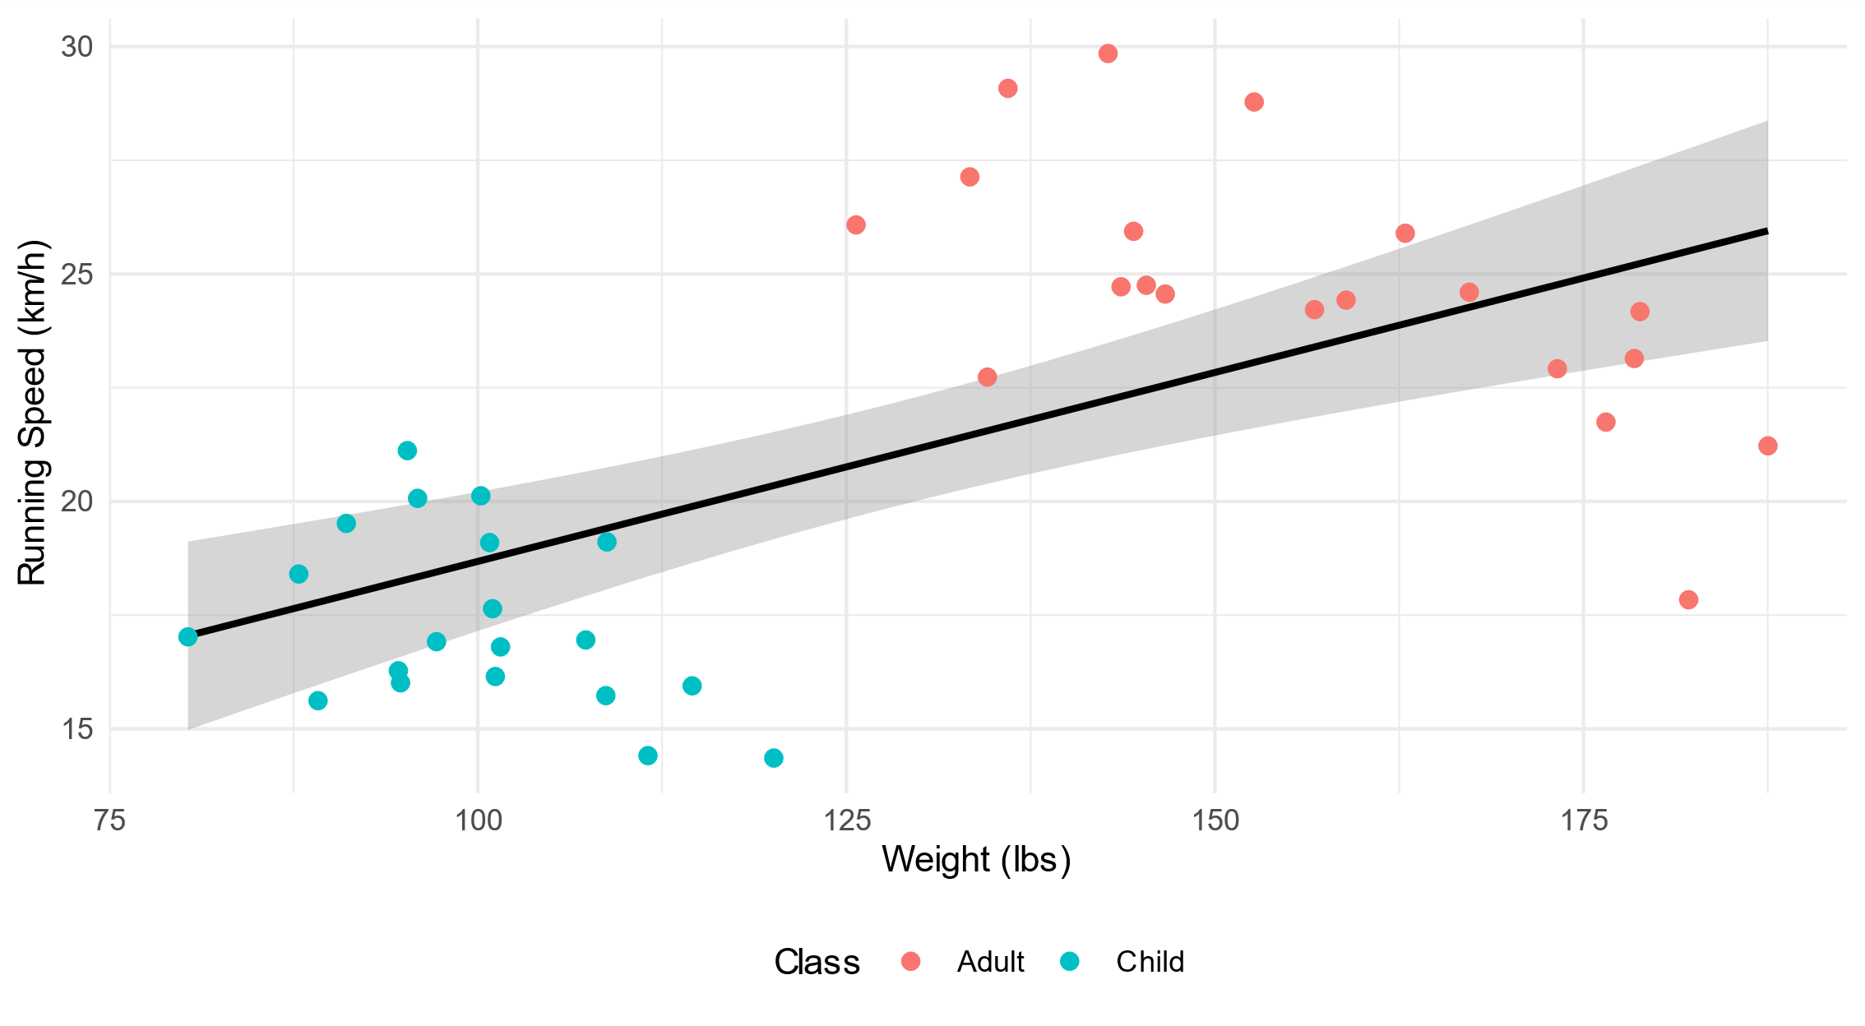
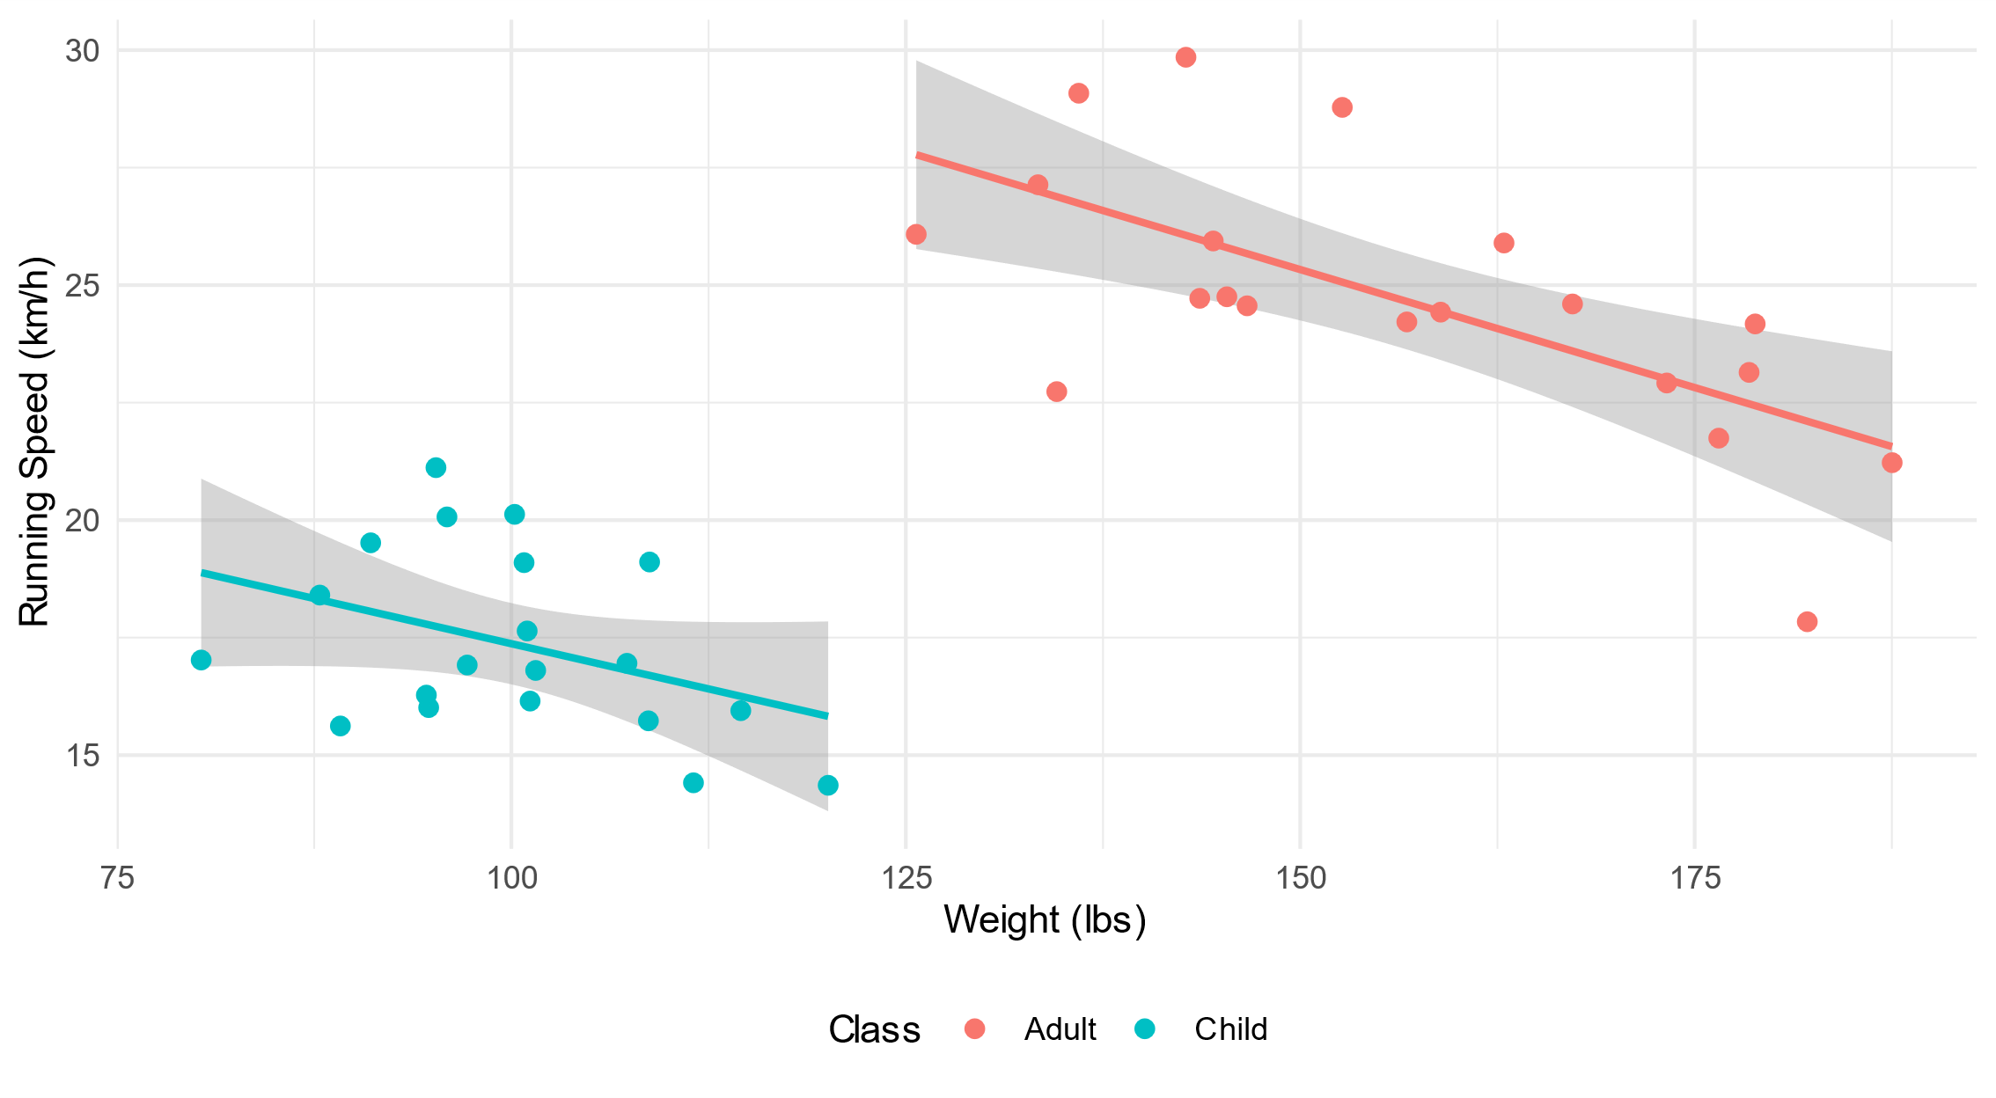

Slide 52
Education
˜
Seeing patterns that aren’t there

Slide 53
Conclusion
˜
Wrapping things up

Slide 54
Only The Tip of The Iceberg
˜
Gerrymandering
Confirmation Bias
Cobra Effect
Survivorship Bias
P-Hacking
Peeking
False Causality
McNamara Fallacy
Publication Bias
Berkson’s Paradox
Summary Statistics
Gambler’s Fallacy
Sampling Bias
Overfitting
Confounding Factors
Overgeneralisation
Confidence Intervals
Base rate fallacy
Frequentist Inference
Will Roger’s Paradox
Multiple Comparisons Fallacy
www.statisticsfortheskeptical.com

Slide 55
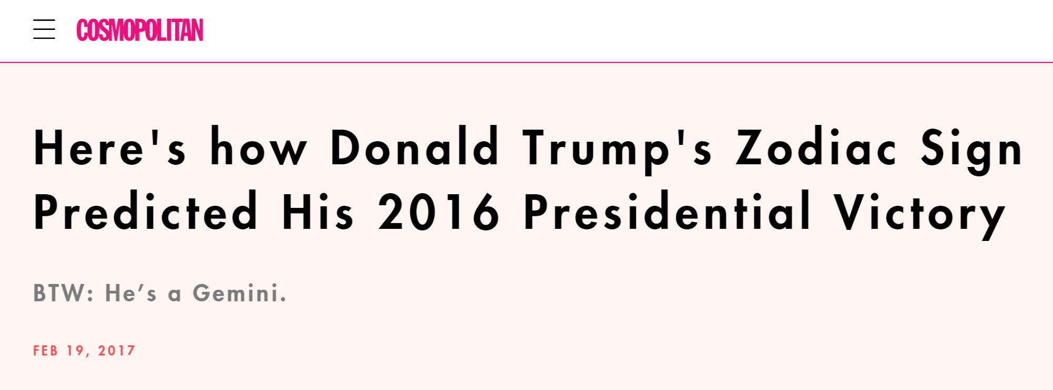
Final Thoughts
˜
Stay Skeptical

Slide 56
Conclusion
˜
Wrapping things up

Slide 57
Thank You For Listening
˜
Tim Hargreaves
tim.hargreaves@icloud.com
linkedin.com/in/tim-Hargreaves
github.com/THargreaves
ttested.com
statisticsfortheskeptical.com

